Slide 1
POWER APPS

Slide 2
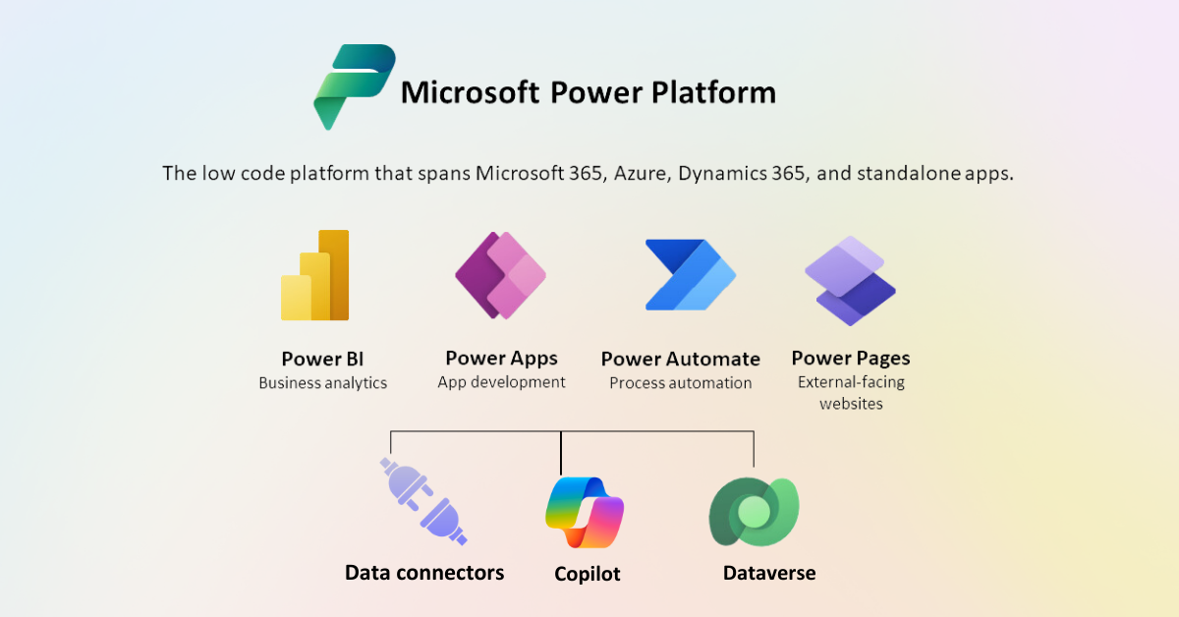
Microsoft Power Platform

Slide 3
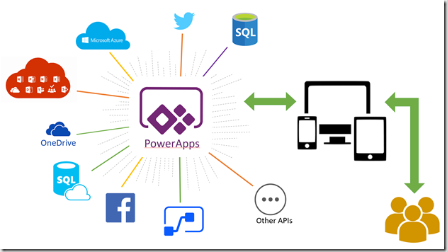
What is Power Apps?
Power Apps is a suite of apps, services, and connectors, as well as a data platform, that provides a rapid development environment to build custom apps for the business needs.
Using Power Apps, we can quickly build custom business apps that connect to our data stored either in the underlying data platform (Microsoft Dataverse) or in various online and on-premises data sources (such as SharePoint, Microsoft 365, Dynamics 365, SQL Server, and so on).

Slide 4
Power Apps for app makers/creators
To create an app, you start with make.powerapps.com .
Power Apps Studio is the app designer used for building canvas apps. The app designer makes creating apps feel more like building a slide deck in Microsoft PowerPoint.
App designer for model-driven apps lets you define the sitemap and add components to build a model-driven app.

Slide 5
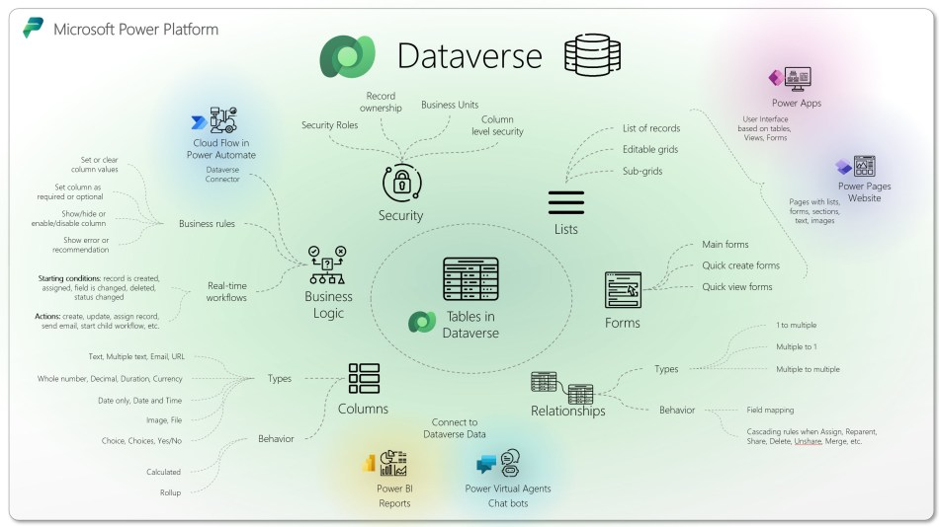
Dataverse
Dataverse is the data platform that comes with Power Apps and allows you to store and model business data.
Data within Dataverse is stored within a set of tables.

Slide 7
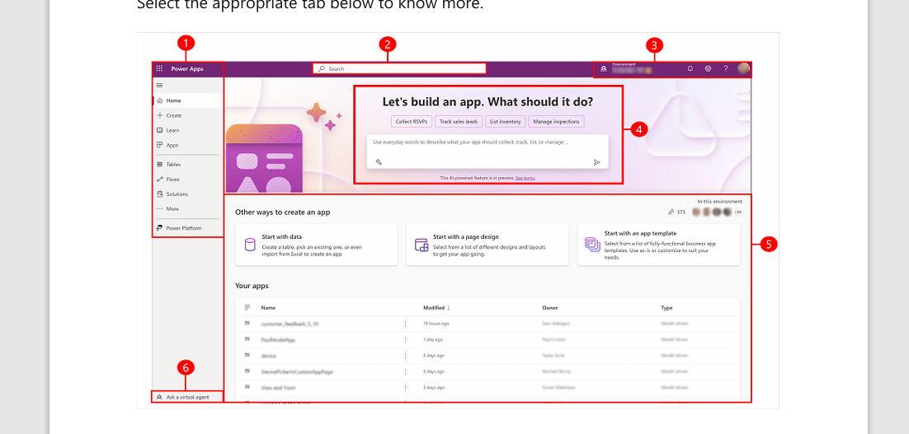
Get Started With Power Apps Development process
Legend:
1. Left navigation pane
2. Search
3. Environment information and settings
4. Copilot in Power Apps
5. Build apps
6. Get help from a virtual agent

Slide 8
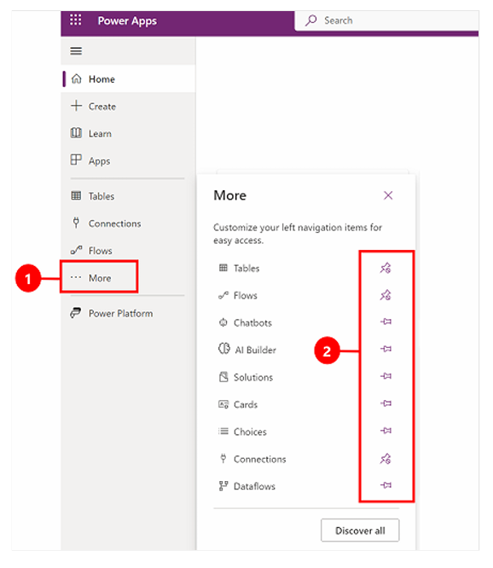
To pin or unpin a page from the left navigation pane, select More, and then select the pin or unpin button.

Slide 9
Components of Power apps

Slide 10
Gallery
Power Apps Gallery is a type of control that can display a set of records from a data source.
In the gallery, each record holds multiple types of data.
Also, it can contain other input controls.

Slide 11
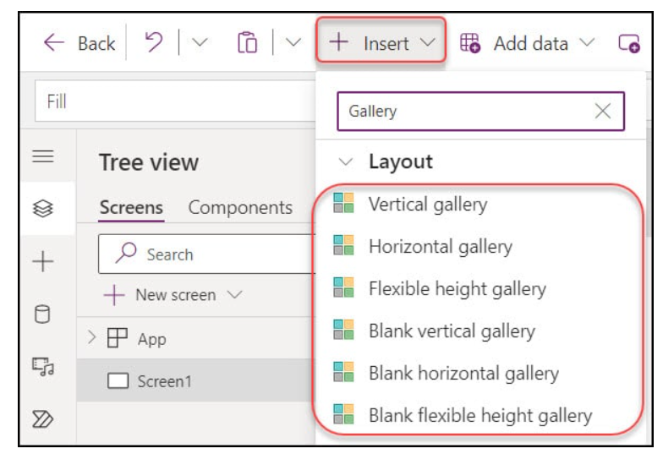
Power Apps Gallery Types
Vertical gallery
Horizontal gallery
Flexible height gallery
Blank vertical gallery
Blank horizontal gallery
Blank flexible height gallery

Slide 12
Gallery Limitations
Limitation Category | Description
Item Display | Gallery control displays items in a single column (for vertical galleries) or a single row (for horizontal galleries), so layouts with multiple columns/rows need workarounds.
Data Source | While the gallery can connect to many data sources, performance may vary, especially with large data sets. Fetching and rendering thousands of items can be slow.
Item Limit | There’s a limit to the number of items a gallery can display, driven by the “Data row limit” for non-delegable queries (500, by default, can be increased to 2,000).

Slide 13
Not Supported Controls | Within a gallery, the following controls are not supported: – Display form – Edit form – PDF viewer – Power BI tile – Rich text editor – Scrollable screen (Fluid grid)
One Gallery can be added | Only one gallery can be added inside of another gallery.
TemplateSize | TemplateSize must be at least one. If you don’t consider the template size, controls in the Gallery may deviate from their intended X or Y values.

Slide 14
Screen
Main Screen:
The default or landing screen of your app. Typically used to present the primary user interface.
Detail Screens:
Screens that display detailed information about a specific item or record. Often used in conjunction with data sources.
Edit Screens:
Screens where users can input or modify information. These screens usually have forms or input controls.

Slide 15
List Screens:
Screens that display a list of items or records, allowing users to browse through and select items.
Splash Screens:
Optional introductory screens that may show branding, loading information, or a welcome message.
Error Screens:
Screens designed to handle and display error messages or issues that occur within the app.

Slide 16
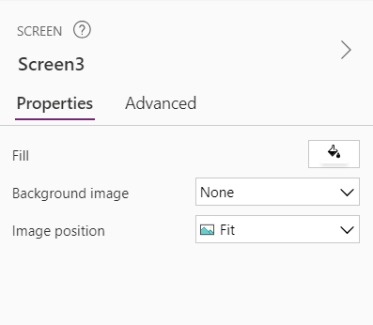
Colour contrast
The Screen is the effective background for text, there must be adequate color contrast between:
Fill and text
Backgroung image and text (if applicable)
There must be a meaningful name for each Screen.

Slide 17
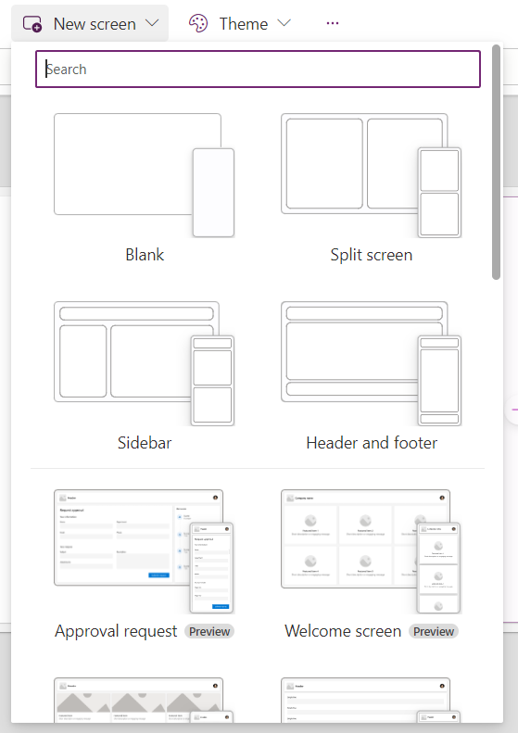
When you click on new screen, you can see lots of variety screen in the drop down.
Based on our requirement, we can select our screen.

Slide 18
Card

Slide 19
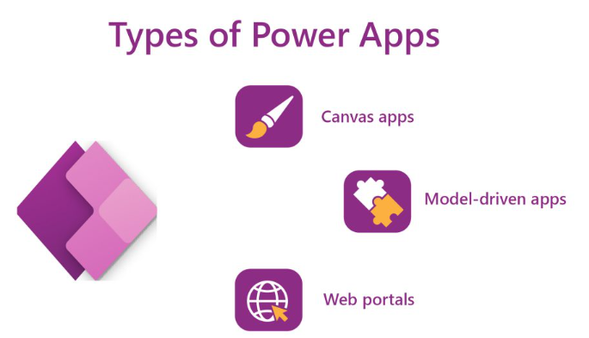
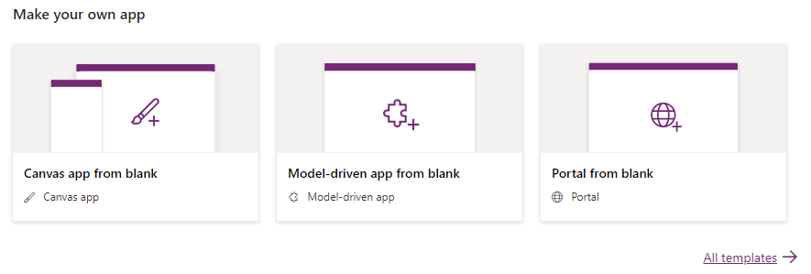
Power Apps Types
Canvas Apps
Model Driven Apps
Power Apps Portal

Slide 20
Canvas apps
We can build canvas apps for web, mobile, and tablet applications.
Canvas apps are apps that start with a blank canvas, where the user can design the user interface (UI) by dragging and dropping elements such as buttons, text boxes, galleries, forms, and media.
Canvas apps can connect to various data sources and services using connectors, such as SharePoint, Excel, SQL Server, Twitter, and more.

Slide 21
Key characteristics of canvas apps
No coding required: Building apps doesn’t require writing code in programming languages like C#. Instead, you drag and drop pre-built controls like buttons, galleries, and text boxes onto a canvas, similar to designing a PowerPoint slide.
Data integration: Canvas apps seamlessly connect to various data sources within Dynamics 365, including Common Data Service (CDS), customer relationship management (CRM), and enterprise resource planning (ERP) data. This allows you to display, create, update, and delete data directly within the app.
Customisable: The platform offers a vast library of ready-made controls and templates, enabling you to create unique and user-friendly applications. You can customise the look and feel, functionality, and data connections to match your specific requirements.
Embedding: Canvas apps can be embedded directly within Dynamics 365 forms, dashboards, and portals, providing context-specific functionality alongside existing data and features. This streamlines workflows and eliminates the need to switch between different applications.
Accessibility: Power Apps offers native mobile functionality, allowing you to build apps accessible on smartphones and tablets, further enhancing mobility and flexibility for users.

Slide 22
Naming Conversion
Screen Names
Control Names
Variable Names
Collection Names
Datasource Table Name
Naming Conversion

Slide 23
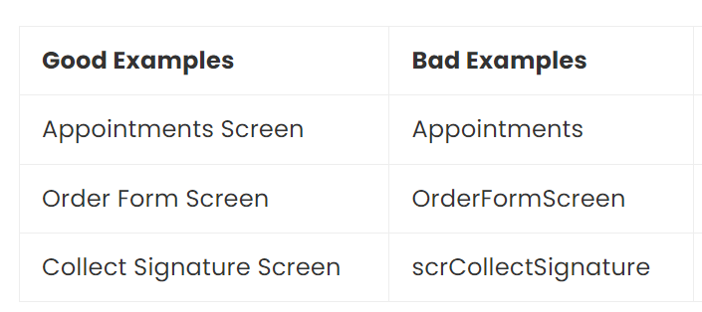
Screen Names
A screen name should clearly describe its purpose in 2-3 words ending with word “Screen.”
Use proper-case.
A screen-reader will speak the screen name to visually-impaired users when the screen loads.

Slide 24
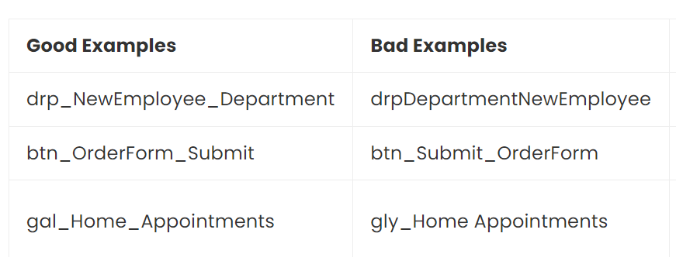
Control Names
A control name should show the control-type, the purpose and the screen.
Use camel-case and underscores for spacing.
For example, the control named txt_OrderForm_FirstName is a text input that captures first name on the app’s Order Form Screen.

Slide 25
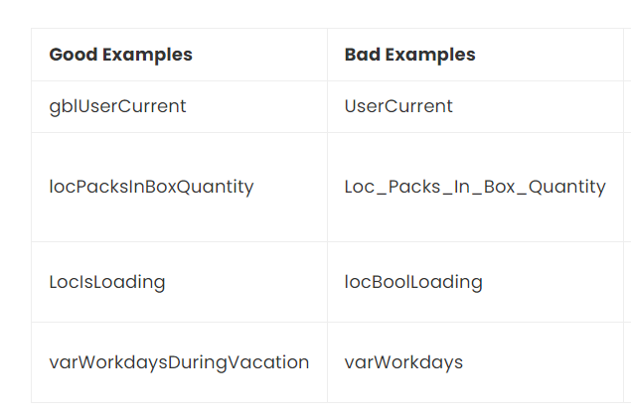
Variable Names
A variable name should show the scope of the variable and its purpose.
Use camel-case with no spaces between each word.
For example, the variable gblUserEmail is a global variable which holds the current user’s email address

Slide 26
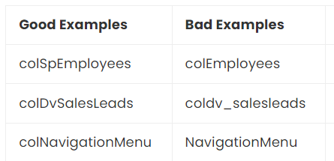
Collection Names
A collection name should contain the original datasource and describe its purpose.
Use camel-case with no spaces between each word.
For example, the collection colDvInvoices is a collection of invoices from Dataverse.

Slide 27
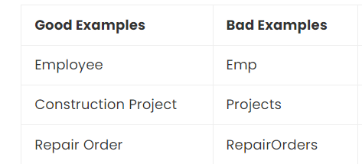
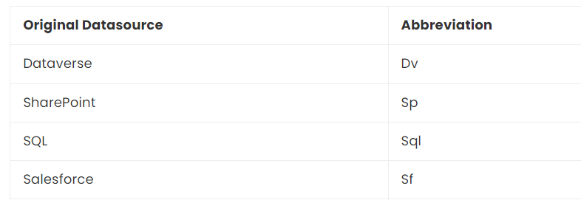
Datasource Table Names
A datasource created by the developer should have 1-3 words to describe its purpose.
Use the singluar form of the word and proper-case.
Be as concise and clear about the purpose of the datasource as possible.

Slide 28
Canvas App – Controls Categories
Input
Display
Layout
Media
Icons
Shapes
Charts

Slide 29
Types of Variables
Three different types of variables which are available in PowerApps
Local variables
Global Variables
Collections
Variables types | Scope | Description | Functions related to variable
Global variable | App | This is similar to a global variable in programming language and it can hold a number, text string, Boolean, record, table, etc as a data value | Set
Context variables | Screen | This is similar to the parameter which we pass to methods or procedure and this variable can be referenced from only one screen | UpdateContext Navigate
Collections | App | This variable can store table which can be referenced across anywhere in the app | Collect ClearCollect

Slide 30

Local Variable
Click on create
1
Select Canvas app from blank as a type of PowerApps
2
Provide the name of the app as contextVariable and select the format as Tablet
3
Add a text input, label, and button from the insert table
4
Select the button and update the formula in OnSelect
5
1.Button Onselect -Update Context({contextVariable:TextInput1.Text})
2.Label – Pass the Local variable Value (ContextVariable)

Slide 31
Global Variable
Select Canvas app from blank as a type of PowerApps
Provide the name of the app as GlobalVariable and select the format as Tablet
Add a text input, label, and button from the insert table
Select the button and update the formula in OnSelect
Syntax: Set(global Variable,TextInput1.Text)
Now select the label field and update the formula in the Text field
global Variable

Slide 32
Collections
Use a collection to store data that users can manage in your app. A collection is a group of items that are similar, such as products in a product list.
Collect, Clear, and ClearCollect functions
Collect: Add Records to Data Source
Clear: Delete Records.
ClearCollect: Add & Delete Records.

Slide 33
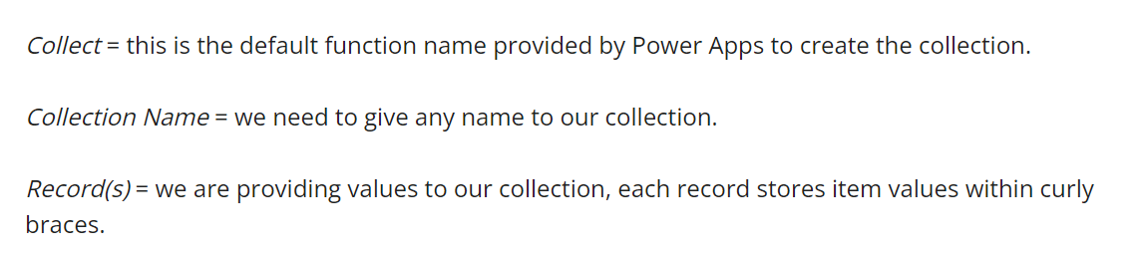
Syntax - Collect (Collection Name, record(s))
Example:
Collect (EmployeeDetails, {EmpID: "11021051", Designation: "Software Developer"}, {EmpID: "11021052", Designation: "Product Manager"}, {EmpID: "11021052", Designation: "HR"})

Slide 34
Patch
Patch function is used to create or update single records or a list of records in the Data source. Using this, values of fields can be modified without affecting other properties. The patch can be used to save data across multiple screens.
Syntax of the Patch function
DataSource: The data source to modify or create records in.
BaseRecord: The record to modify or create.
UpdateRecord: One or more records that contain new property values that override property values in the base record.

Slide 35
Patch Syntax:
Patch(DataSource, BaseRecord, UpdateRecord1[, UpdateRecord2,… ])
DataSource: The data source to modify or create records in.
BaseRecord: The record to modify or create.
UpdateRecord: One or more records that contain new property values that override property values in the base record.

Slide 36
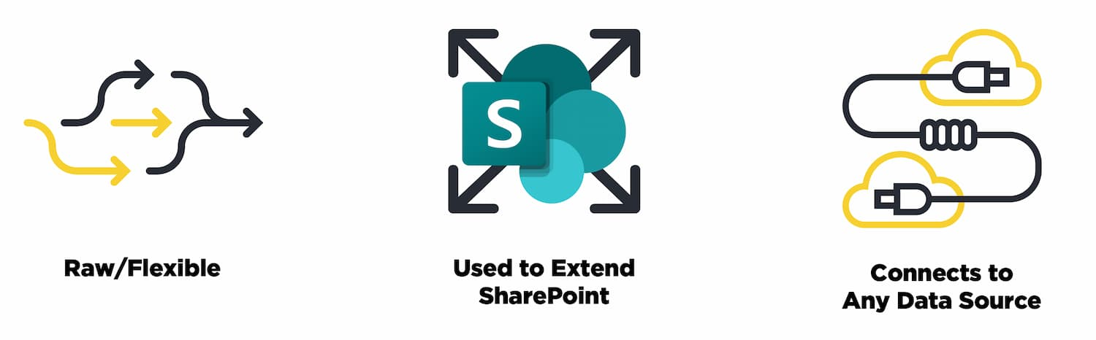
It’s Raw and Flexible
It have a lot of control over the interactions that users have with data and with elements within the app
It’s a Foundation for Extending SharePoint
It opens up a specialized version of a canvas app within Power Apps
It Can Connect to A Lot of Data Sources

Slide 37
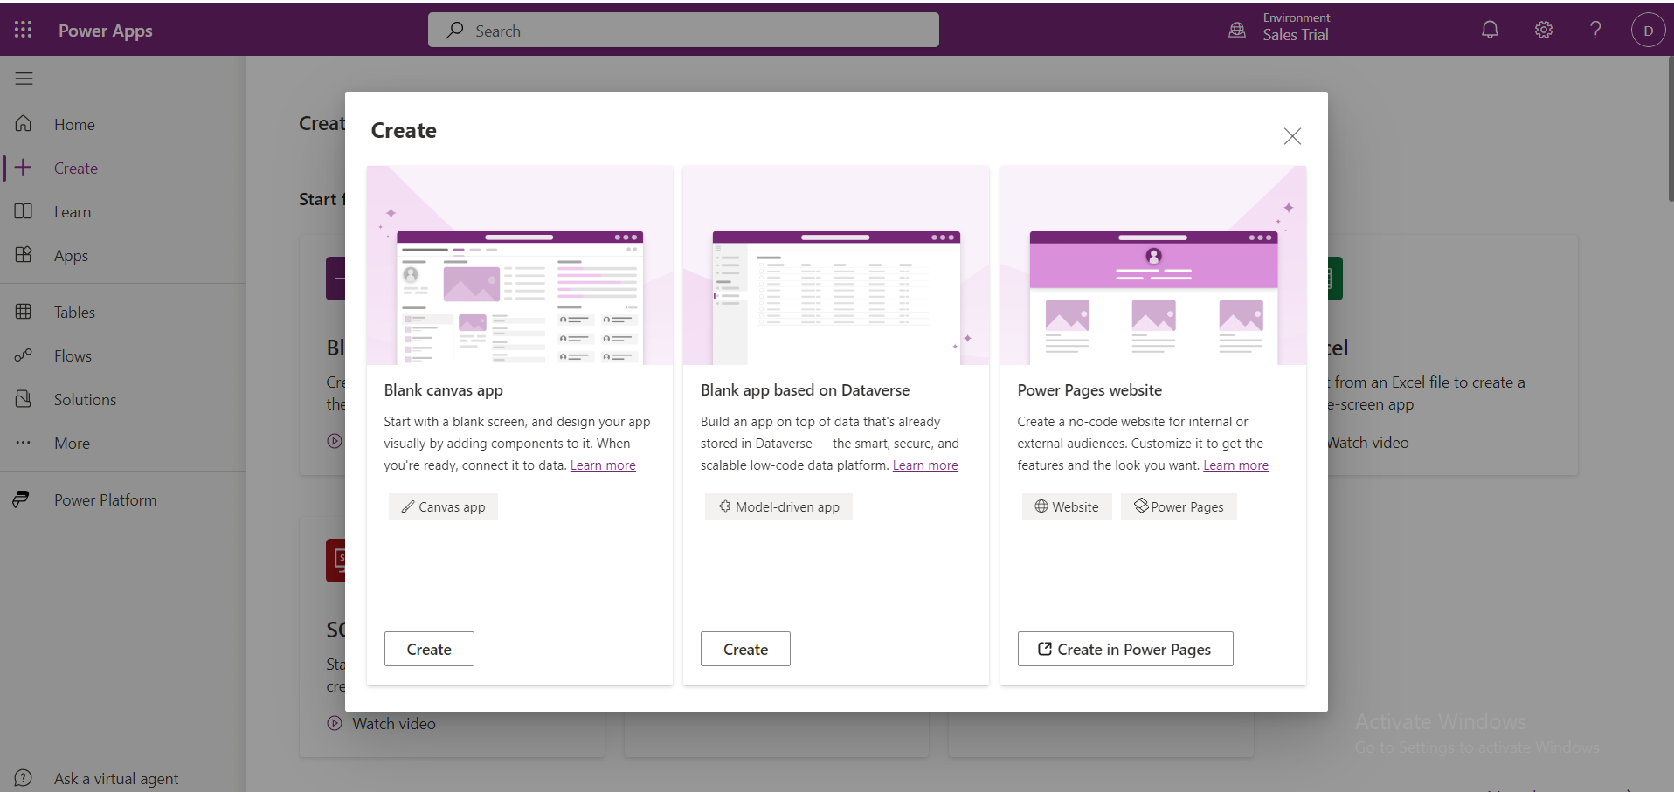
How to create canvas App

Slide 38
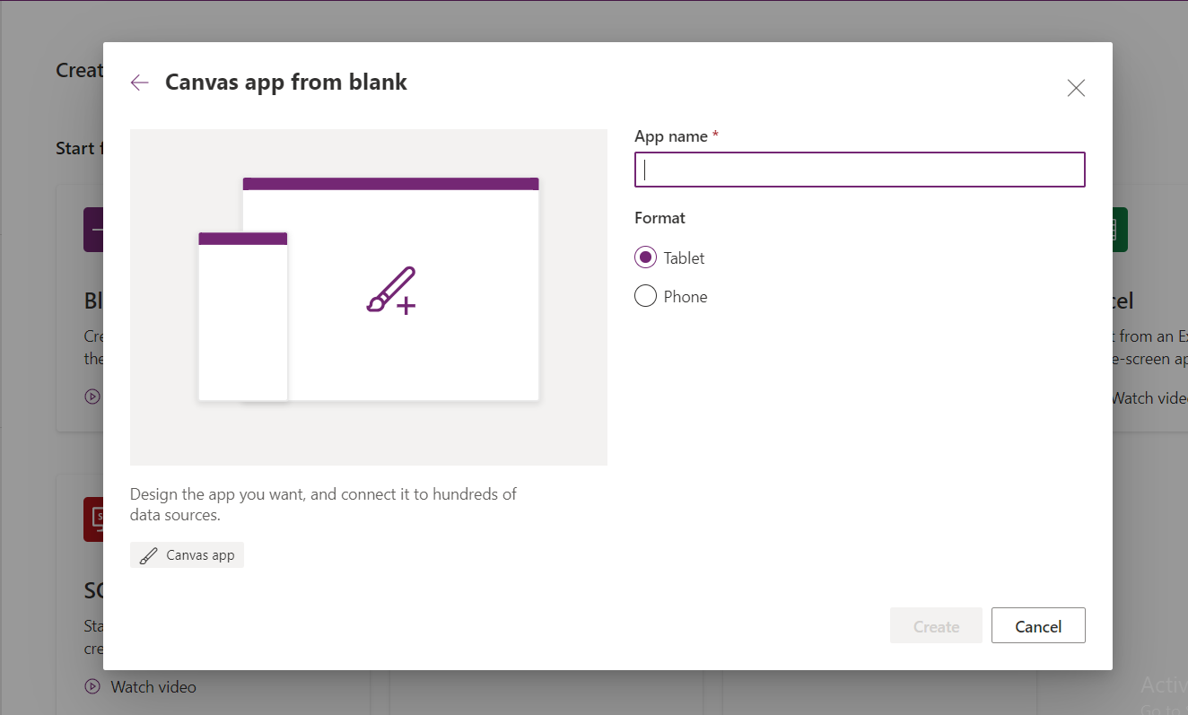
Give the app name here and select anyone format and click create

Slide 39
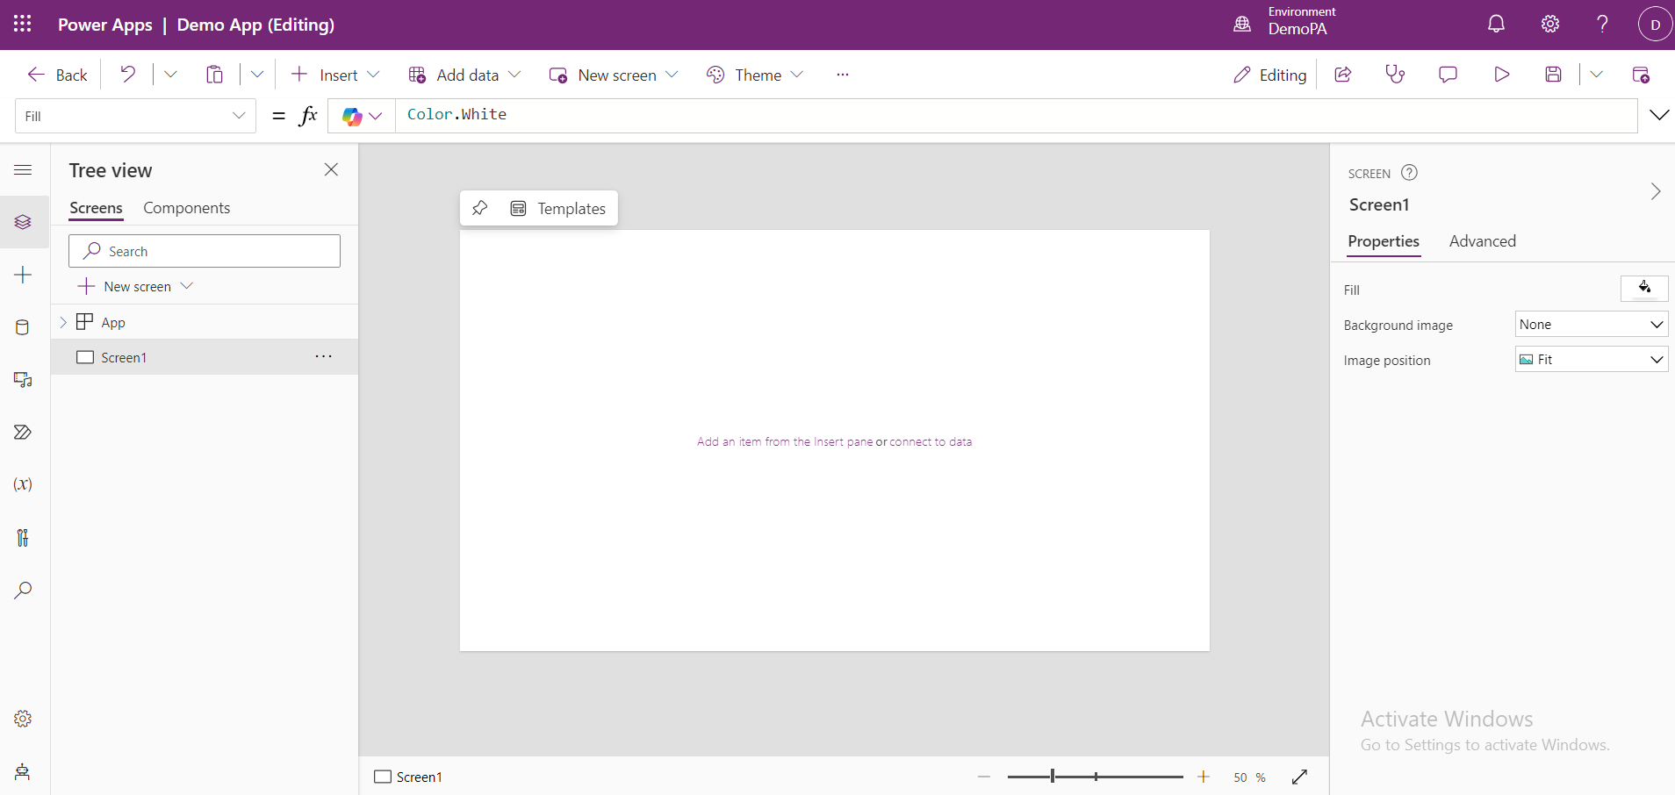
This is the Canvas Editing Page.

Slide 40
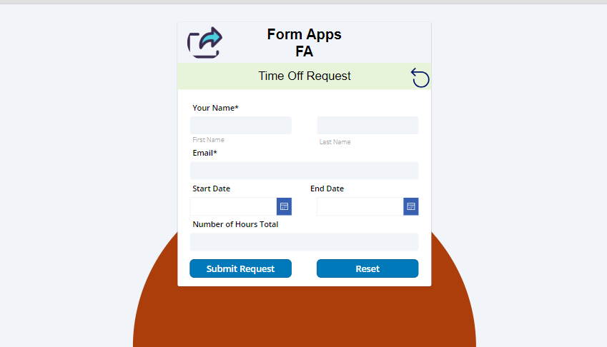
Example

Slide 41
Model-driven apps
Model-driven apps start with your data model – building up from the shape of your core business data and processes in the Dataverse to model forms, views, and other components.
Model driven apps allow the user to focus on the data and the business logic, rather than the UI design.
Getting started with model-driven apps is simple.
Create an app
Create and design forms
Create or edit views
Create or edit a system chart
Create or edit dashboards
Add security
Add business logic

Slide 42
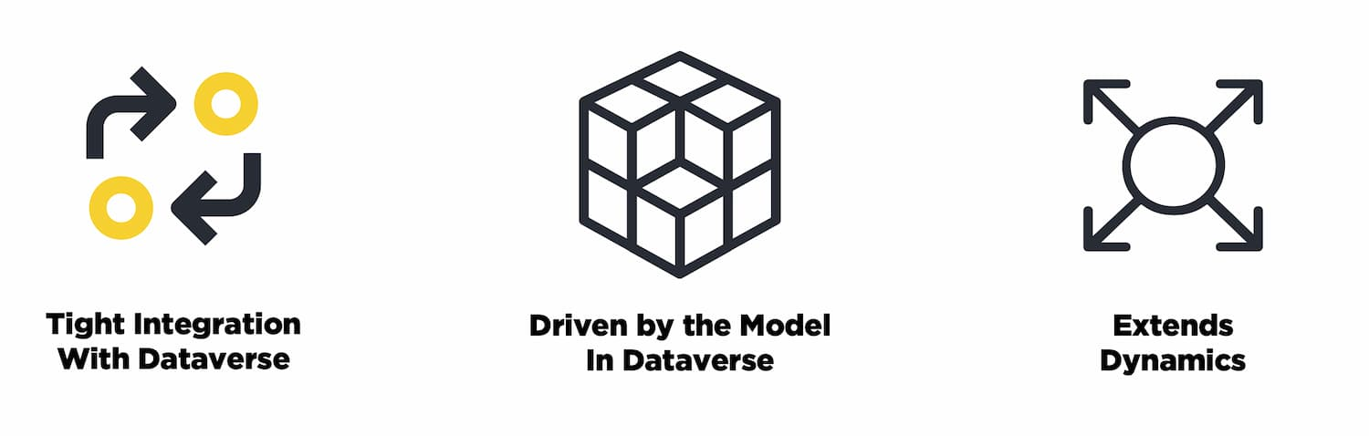
Model-driven apps are a paradigm built squarely on the Dataverse
Defined in Dataverse, Surfaced Through The App
defining the tables and entities within Dataverse with the appropriate forms, dashboards, charts and then surfacing them through a model-driven app
Extends Dynamics
This type of development is also the primary way that Dynamics is extended.

Slide 43
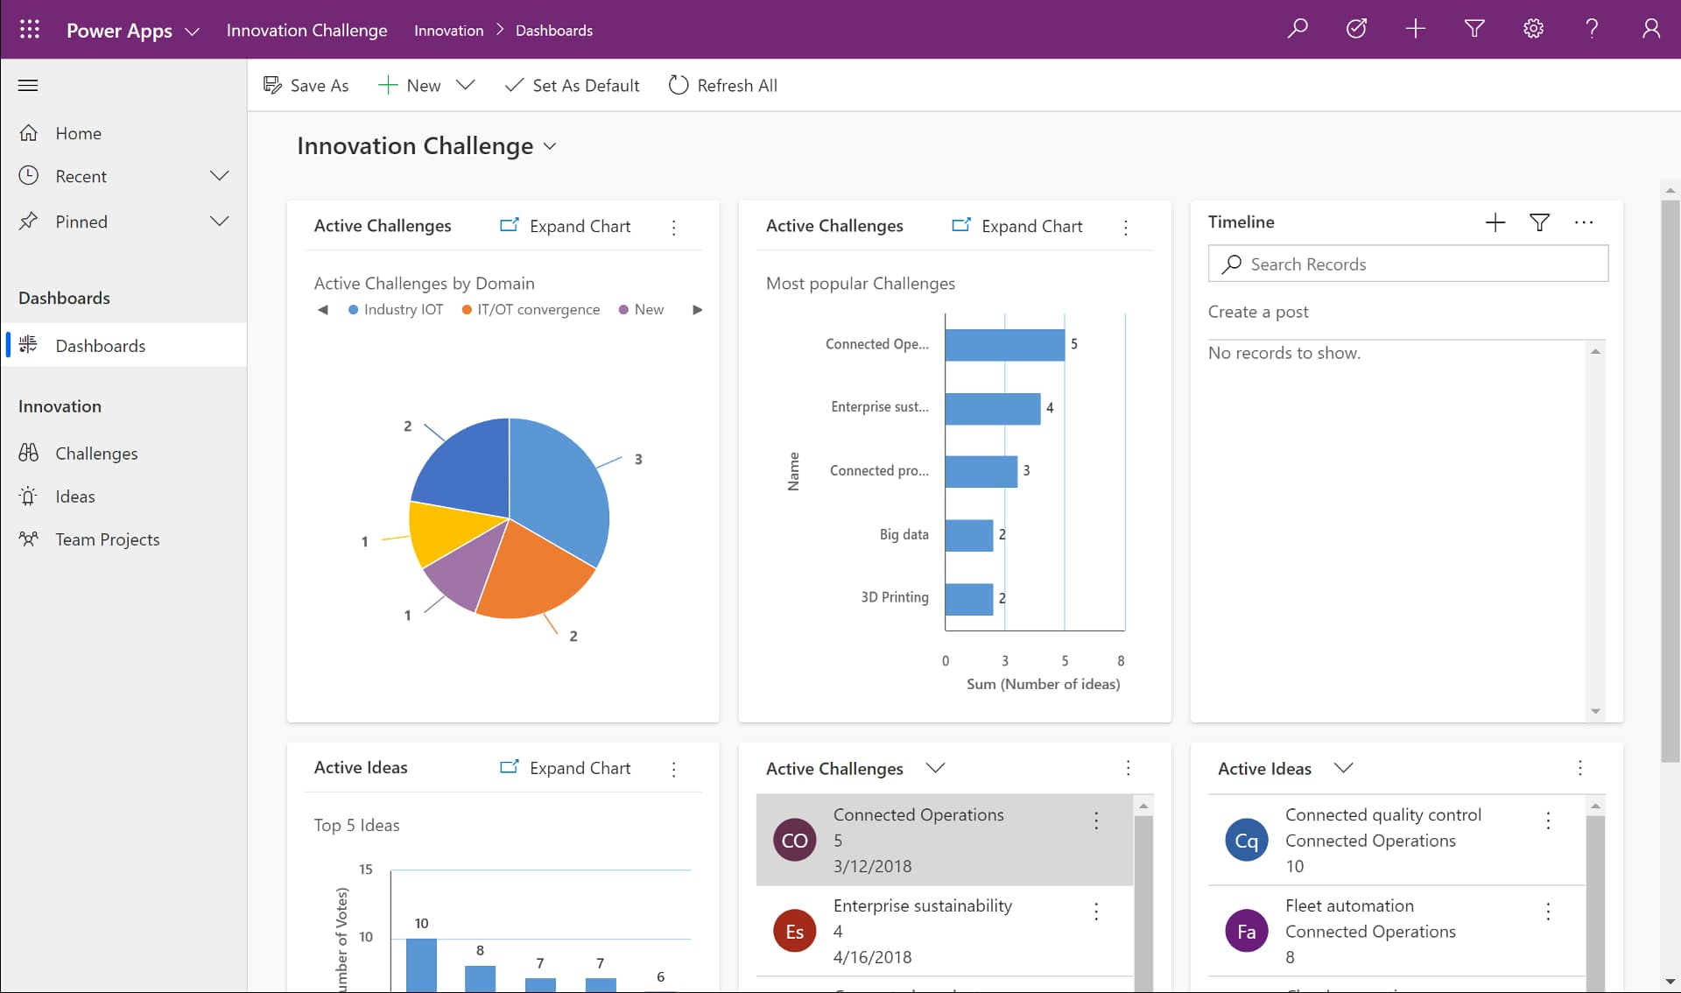
Example

Slide 44
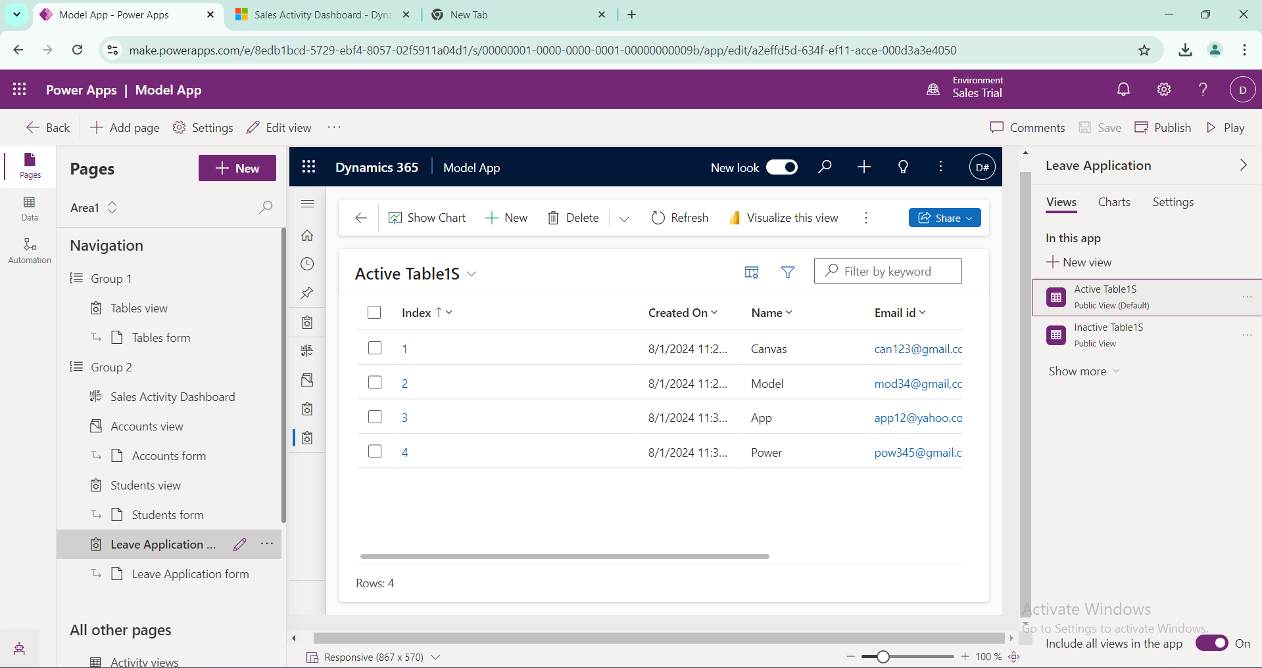

Slide 45
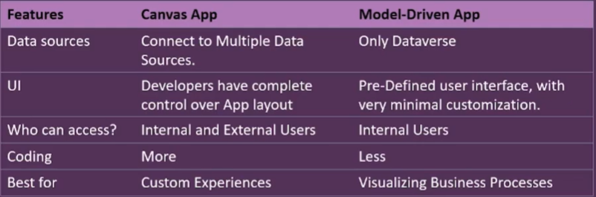
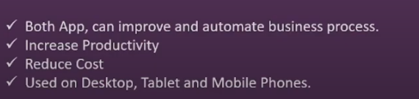
Canvas app Vs Model-driven apps
Similarities

Slide 46
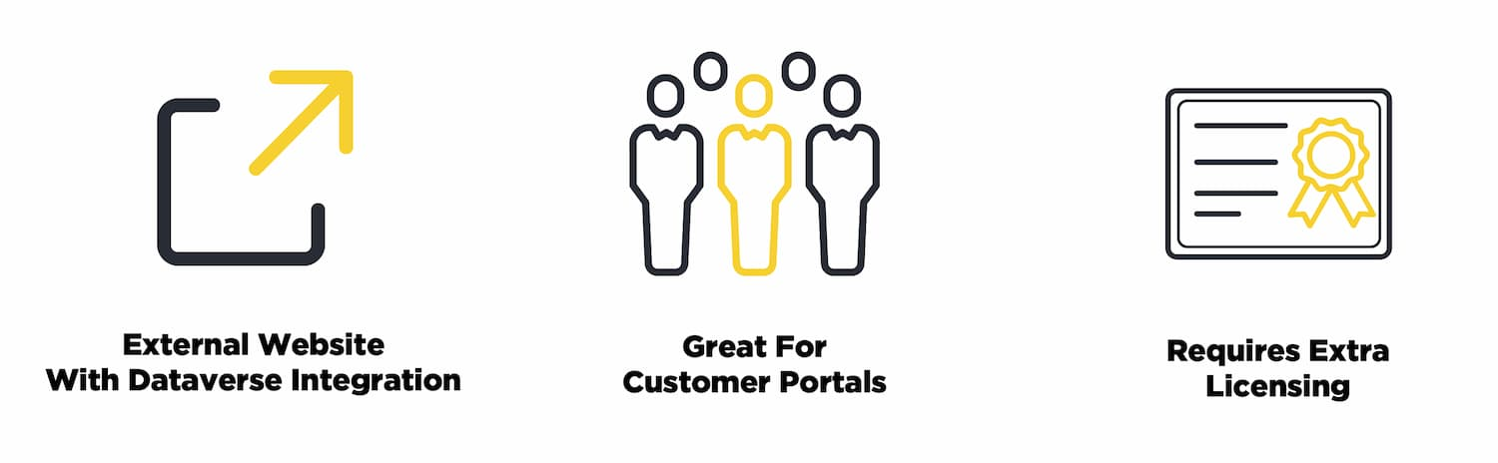
Power Apps Portal
Portals are quite a bit different than the previous two types of apps for a few reasons.
Allow internal and external access to view and update data within dataverse.
Meant for External Access
The Data is All Dataverse Data
Access to Data is Simplified By Using a Portal/Dataverse
Licensing is Much Different

Slide 47
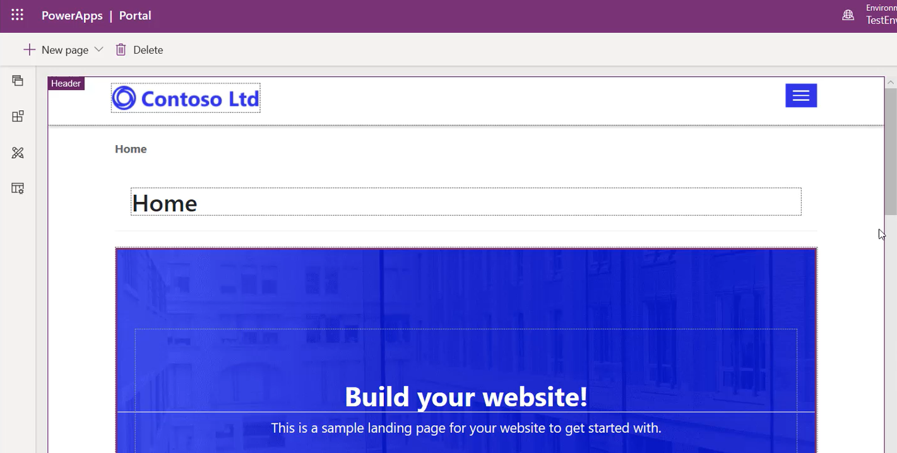
Example

